Slide 1
How to use normalization rules to change the text of invalid language codes in fields 008 and 041
Yoel Kortick
Senior Librarian

Slide 2
  Introduction
  The normalization routines
  The normalization processes
  Running the normalization process on a set
  Results

Slide 3

Introduction

Slide 4
Introduction
In this presentation we will show how to replace text in both control fields and non control fields (using examples 008 and 041)
The changes will be made only when a condition exists.
This means it will not automatically change everything in a set.
It will change only records in the set which meets a certain condition. Further, in the records it will only change the fields which meet a certain condition.

Slide 5
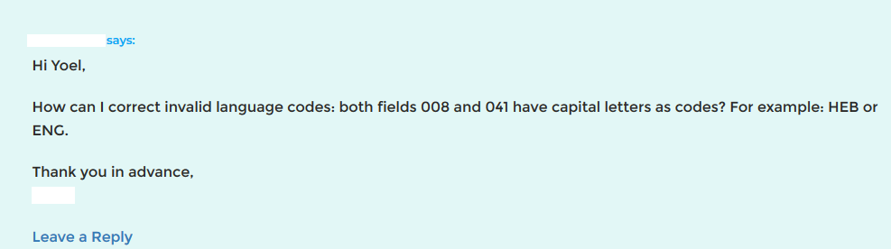
Introduction
Question raised in blog Alma Normalization Rule Examples:

Slide 6
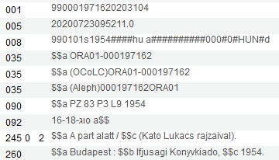
Introduction
For example this record has “HUN” instead of “hun” in position 35-37 of the 008.
The institution wants to change “HUN” to “hun” in position 35-37 of the 008.

Slide 7
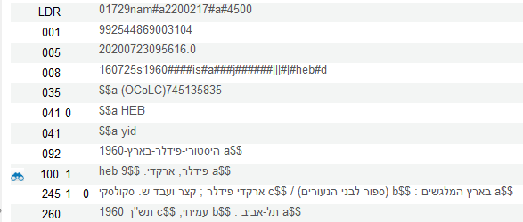
Introduction
For example this record has “HEB” instead of “heb” in 041 subfield a
The institution wants to change “HEB” to “heb” in 041 subfield a

Slide 8
Introduction
In the first case we do not want to change every record in the set to have “hun” in position 35-37 of the 008. We only want to change the record if it has “HUN” in position 35-37 of the 008.
In the second case we do not want to change every record in the set to have 041__ $$a heb. We only want to change the text if it has 041__ $$a HEB.
And even more so: we only want to change the specific field in the record which has 041__ $$a HEB. The record may have multiple 041 fields. We only want to change the field which now has HEB.

Slide 9


The normalization routines

Slide 10
The normalization routines
In this presentation we will show and explain the normalization routines but we will not show how they are created.
To see how the normalization routines are created see:
Section “Creating normalization routines and processes” in Designing and Using Normalization Rules

Slide 11
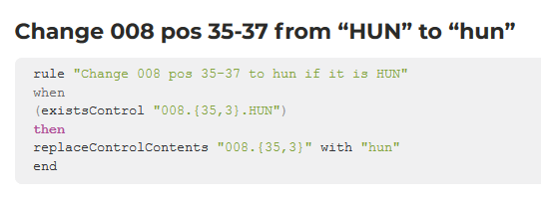
The normalization routines
The normalization routine for changing the 008 pos. 35-37 from “HUN” to “hun” can be found at Alma Normalization Rule Examples

Slide 12
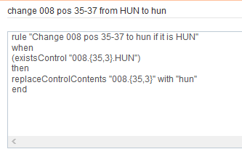
The normalization routines
Here we have created the normalization routine for changing the 008 pos. 15-17 from “HU#” to “hu#” in the metadata editor.
We called it “change 008 pos 35-37 from HUN to hun”
This means only make the change if now there is “HU#” in 008 pos. 15 for 3 positions (which means 15-17)
This means replace whatever is in 008 pos. 15 for 3 positions (which means 15-17) to be “hu#”
The condition here is on the level of the record (after the “when”) and not on the level of the field (after the “replaceControlContents”). The condition can be on the level of the record because there is only one 008 field in the record. We do not need to worry therefore which 008 will be changed – there is only one

Slide 13
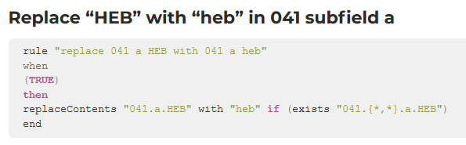
The normalization routines
The normalization routine for changing the 041 subfield a from “HEB” to “heb” also can be found at Alma Normalization Rule Examples

Slide 14
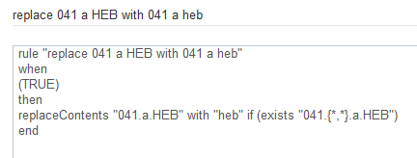
The normalization routines
Here we have created the normalization routine for changing the 041 subfield a from “HEB” to “heb” in the metadata editor.
We called it “replace 041 a HEB with 041 a heb”
This means only change the field if not the field has “HEB” in subfield 041 subfield a.
This means replace the text “HEB” with text “heb” in 041 subfield a
The condition here is on the level of the field (after “replaceContents”) and not on the level of the record after the “when”). The condition must be on the level of the field because there may be multiple 041 fields and we only want to change the one which has “HEB”.

Slide 15

The normalization processes

Slide 16
The normalization processes
In this presentation we will show and explain the normalization processes but we will not show how they are created.
To see how the normalization processes are created see:
Section “Creating normalization routines and processes” in Designing and Using Normalization Rules

Slide 17
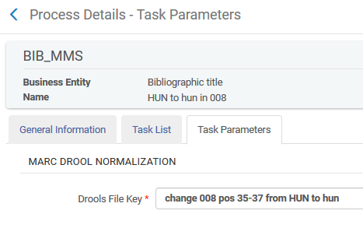
The normalization processes
We have a normalization process called “HUN to hun in 008” which uses the normalization routine we saw earlier called “change 008 pos 35-37 from HUN to hun”.

Slide 18
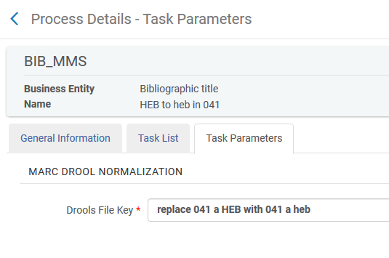
The normalization processes
We have a normalization process called “HEB to heb in 041” which uses the normalization routine we saw earlier called “replace 041 a HEB with 041 a heb”.

Slide 19
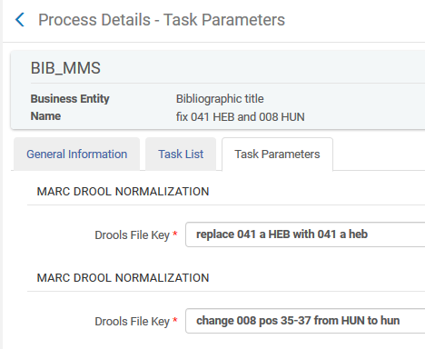
The normalization processes
We have a normalization process called “fix 041 HEB and 008 HUN” which uses both normalization routines:

Slide 20

Running the normalization process on a set

Slide 21
Running the normalization process on a set
We have a set which contains, among other records, these MMSIDs:
  990001971620203104
  992544869003104
  992483369903104
The set is named “records to fix HUN and HEB”

Slide 22
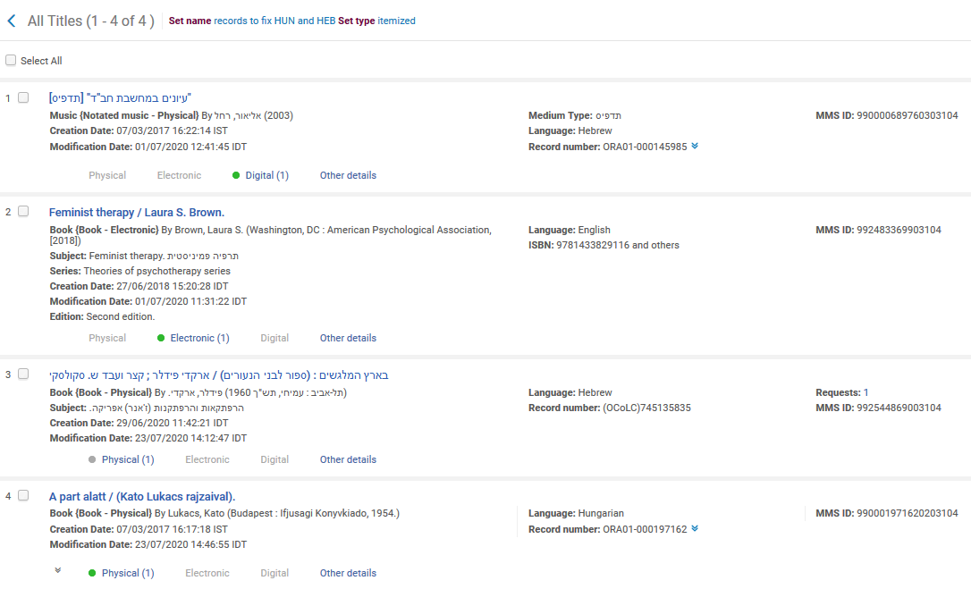
Running the normalization process on a set

Slide 23
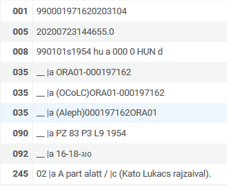
Running the normalization process on a set
990001971620203104 has “HUN” in 008 pos. 35-37 (it should change to “hun”)

Slide 24
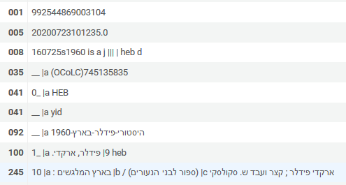
Running the normalization process on a set
992544869003104 has “HEB” in 041 subfield a (it should change to “heb”)

Slide 25
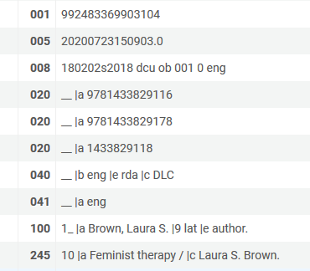
Running the normalization process on a set
Another record in the set is MMSID 992483369903104.
It has neither HUM in 008 pos. 35-37 nor HEB in 041 subfield a (nothing should change)

Slide 26
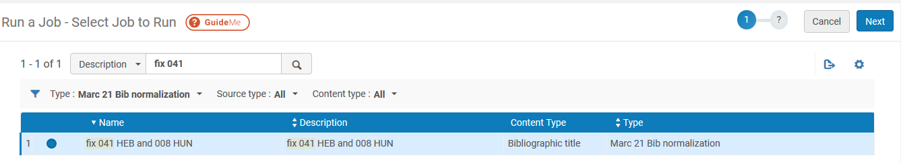
Running the normalization process on a set
From menu “Admin > Manage Jobs and Sets” choose “Run a Job”.
Find the desired MARC 21 Bib Normalization, select it and click “Next”
Search for it here
This is the normalization process we made which contains both normalization rules

Slide 27
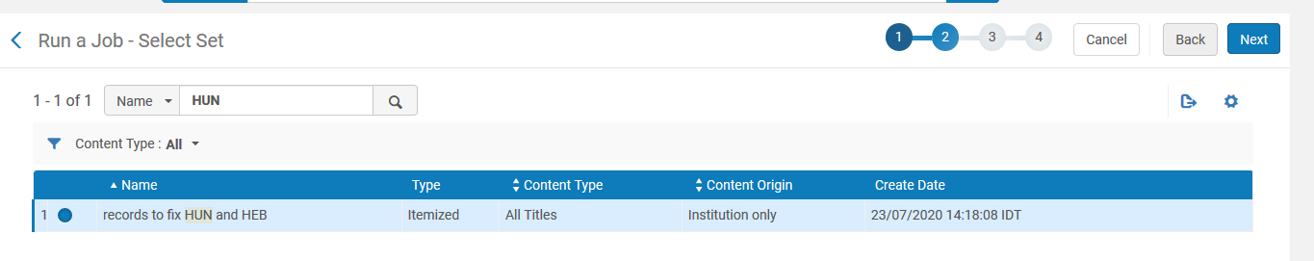
Running the normalization process on a set
Search for the set of records to update and select it. Click “Next”.
Search for it here
This is the normalization process we made which contains both normalization rules

Slide 28
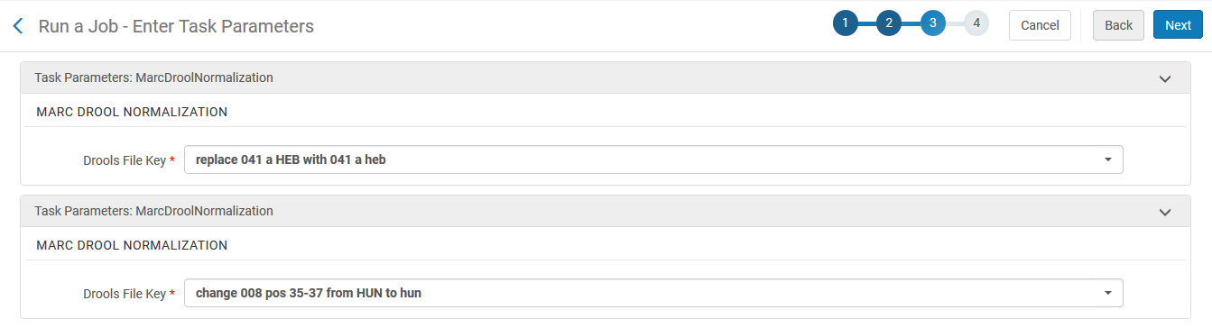
Running the normalization process on a set
Leave the default normalization routines as they are (coming form the normalization process). Click “Next”.

Slide 29
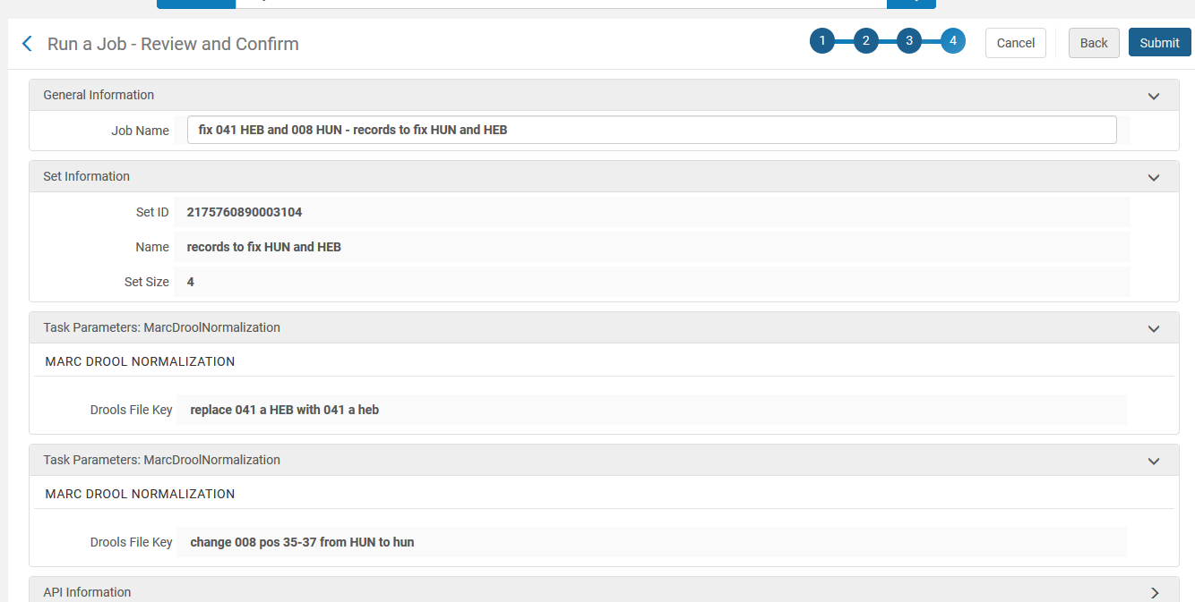
Running the normalization process on a set
Confirm the parameters and click “submit”

Slide 30

Results

Slide 31
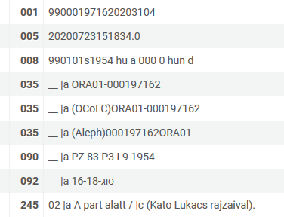
Results
990001971620203104 has now has “hun” instead of “HUN” in 008 pos. 35-37
Before | After

Slide 32
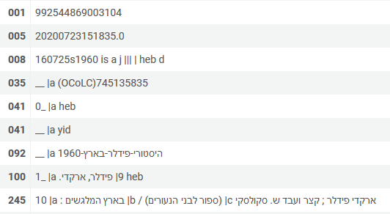
Results
992544869003104 has now has “heb” instead of “HEB” in 041 subfield a
Before | After
The other 041 correctly did not change

Slide 33
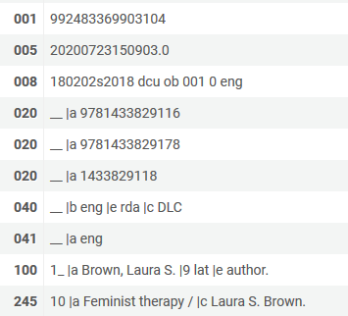
Results
992483369903104 did not change at all. This is correct because it did not meet any of the criteria of the rules.
Before | After

Slide 34
xxx@exlibrisgroup.com

